Slide 1
CoverMyMeds
Saves 15 minutes per medication!
Neal Fraser, Solutions Manager
04/04/2018

Slide 2
CoverMyMeds- Saves valuable time for office and patients
CoverMyMeds integration allows providers to complete prior authorizations of medications through NextGen Office
CoverMyMeds is scheduled to be released August 16th
  Prospective workflow is developed within NextGen Office
    Workflow of the provider initiating a PA at the point of prescribing
  Plan to add Retrospective workflow in the future (pharmacy initiating PA) but no ETA
700,000 providers on 500 plus EHRs use CoverMyMeds
  Many of our providers likely use it on the web based version

Slide 3
Why is CoverMyMeds important?
Some medications require a prior authorization from the patients insurance in order for the patient to receive the medication they need
A Prior Authorization takes 20 minutes and 3-5 business days through manual
  5 minute process with CMM and 1-2 Business days
Reduces issue of patient abandonment
  If we can get the ePA approved quicker, the patient is more likely to get and take the medication
1 in 20 Electronic Medications require a pre-authorization
  Common workflow in many of our clients offices
  Helps with Patient Satisfaction, Physician Burnout, and Staff Satisfaction

Slide 4
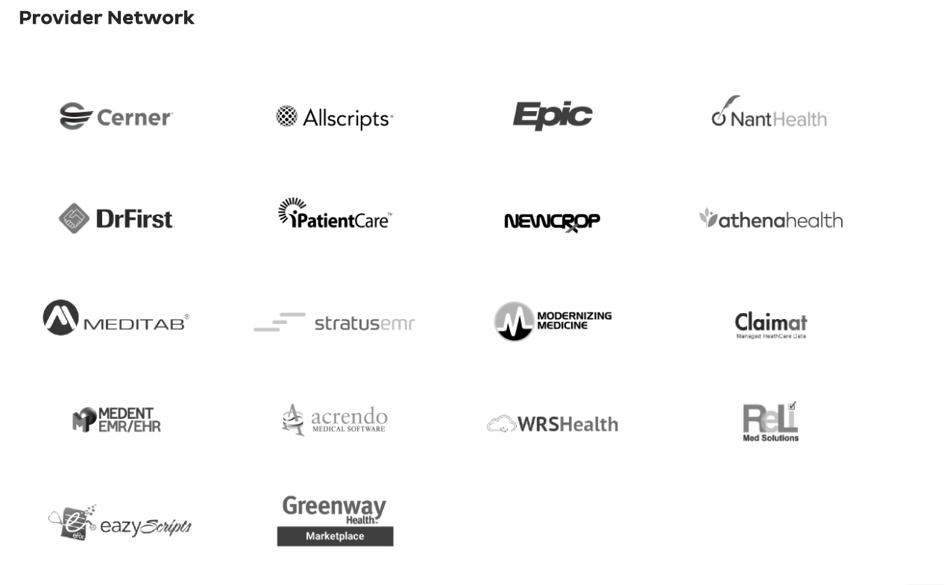
And me feature, but still a differentiator

Slide 5
Provider Workflow

Slide 6
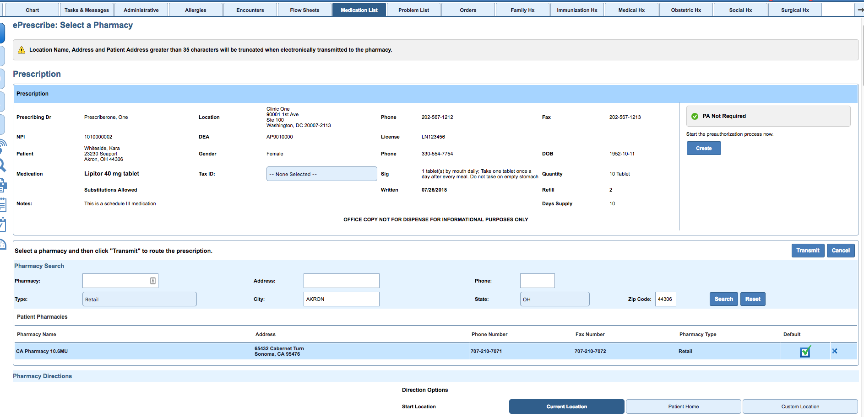
Provider Workflow
Prescriber is notified an authorization is required with in normal workflow

Slide 7
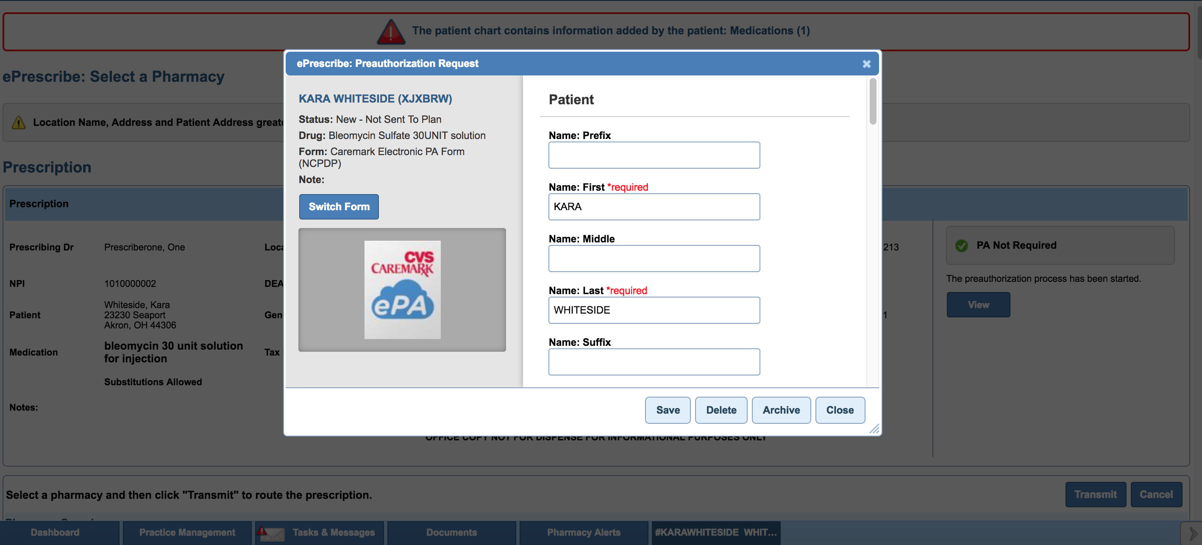
Provider Workflow
If required, the provider will be presented with the appropriate form or can search for another form

Slide 8
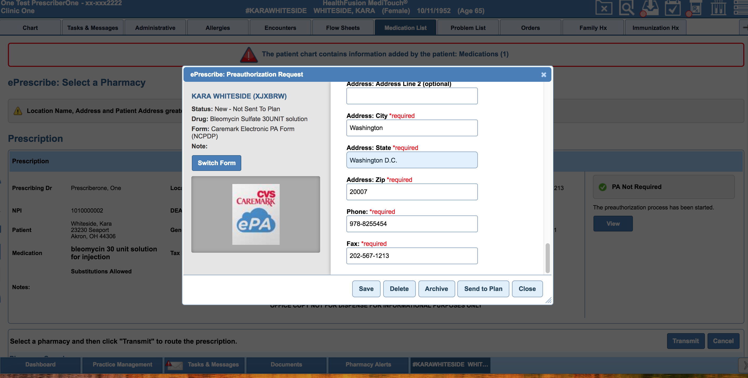
Provider Workflow
We will populate as much information as possible in the form. The provider completes the rest sends ePA to the plan

Slide 9
Provider Workflow- Task Staff

Slide 10
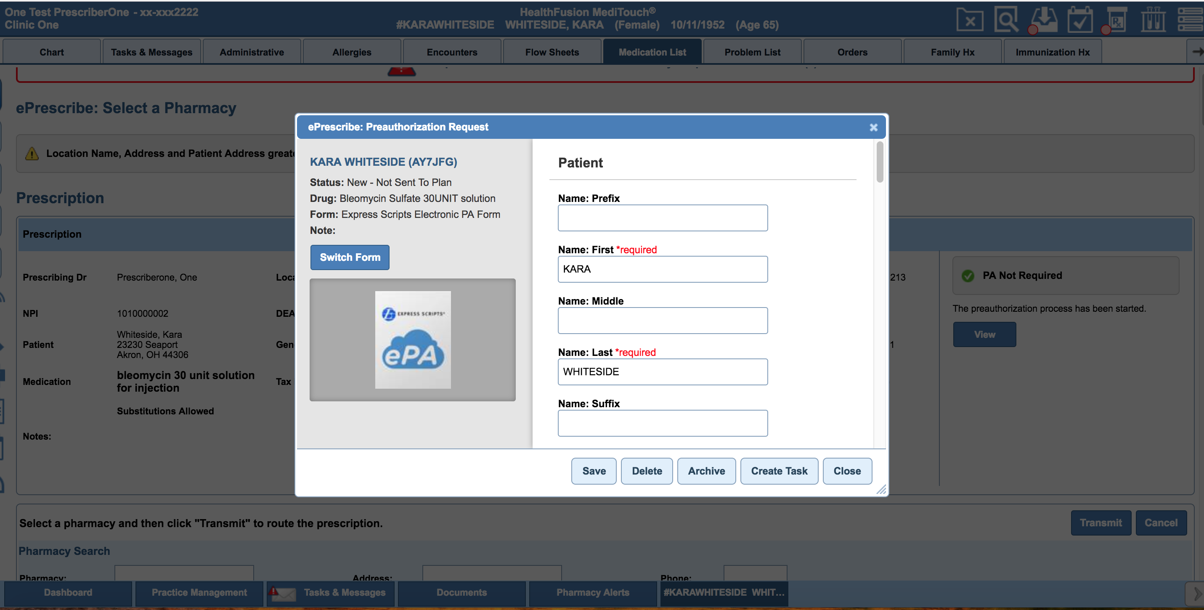
Provider Workflow- Task to Staff
Alternatively the provider can task the ePA to a staff member

Slide 11
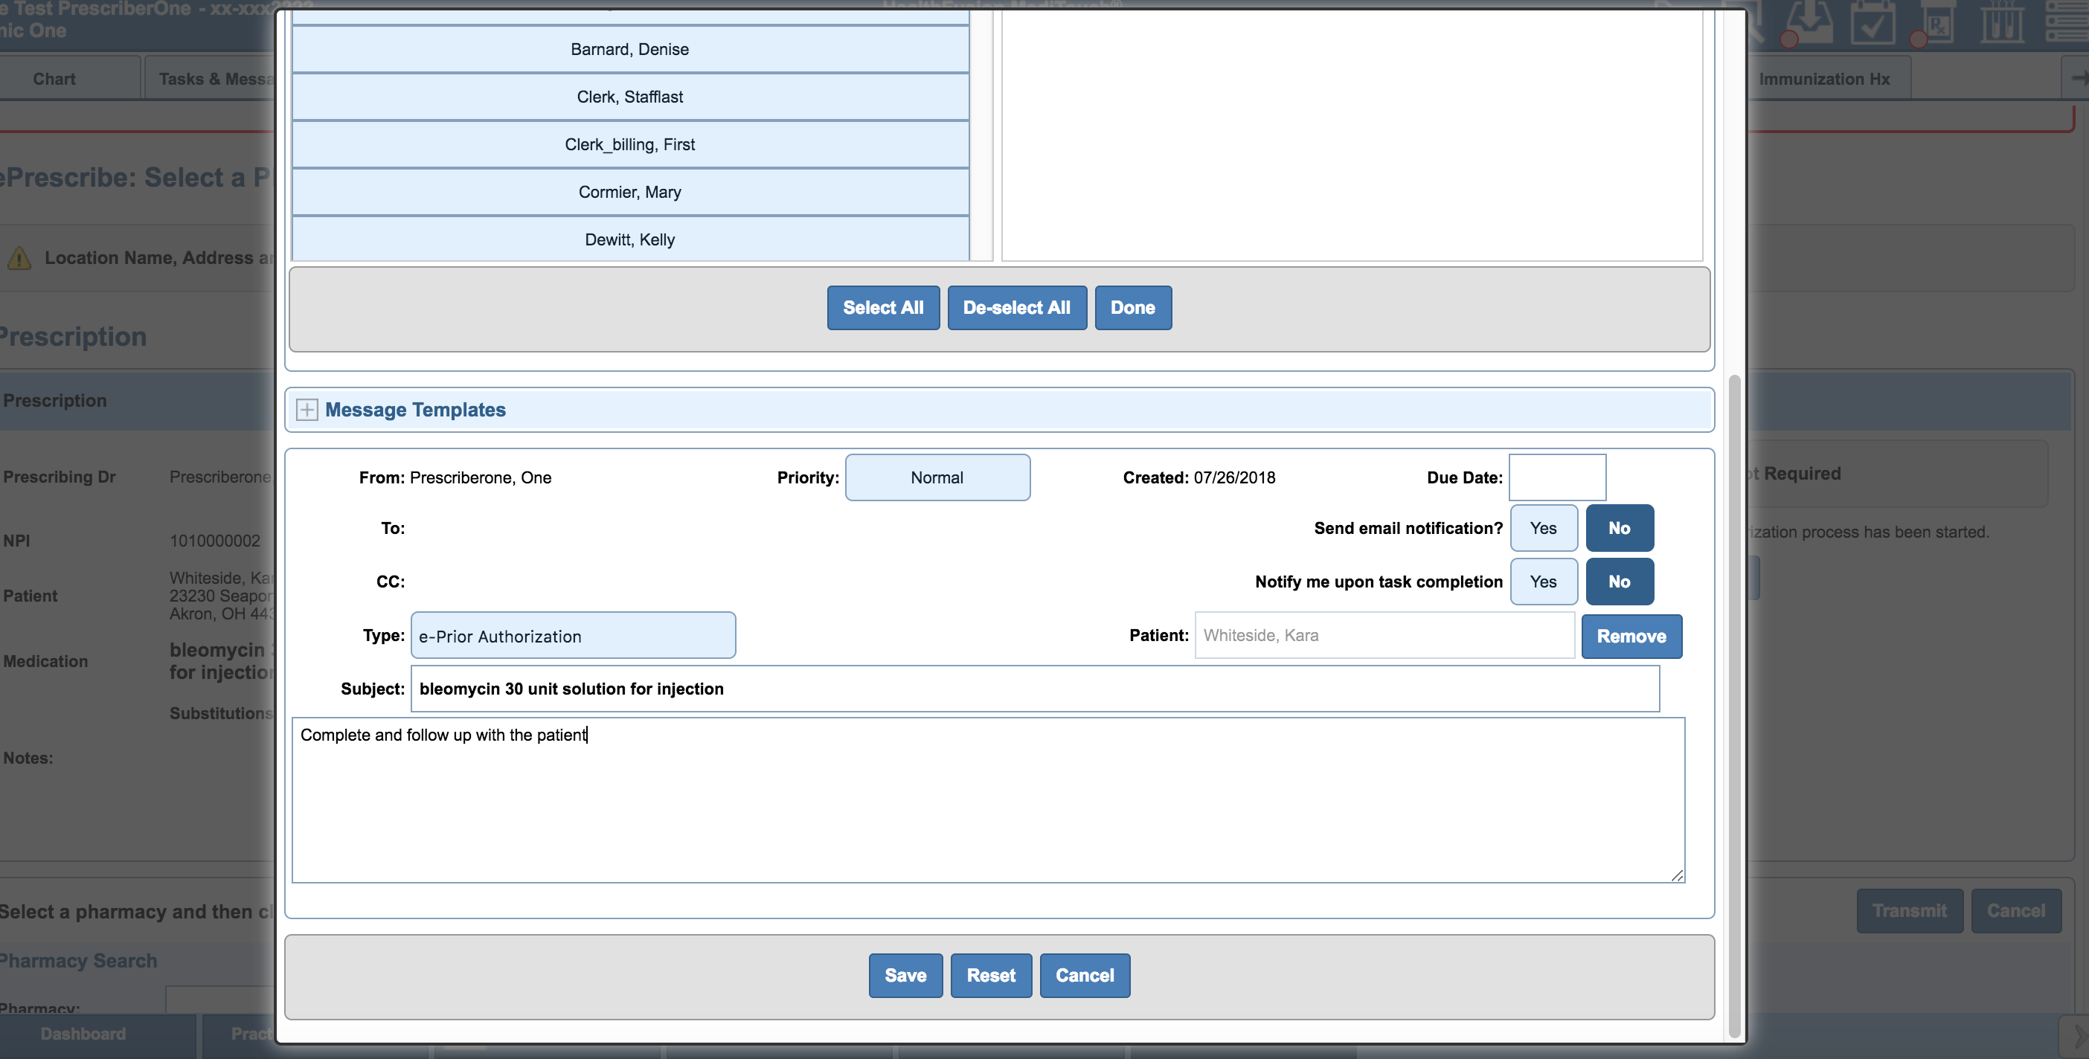
Provider Workflow- Task to Staff
The task is pre-populated; the provider needs to choose the staff member and add information to the body

Slide 12
Staff- Work EPA

Slide 13
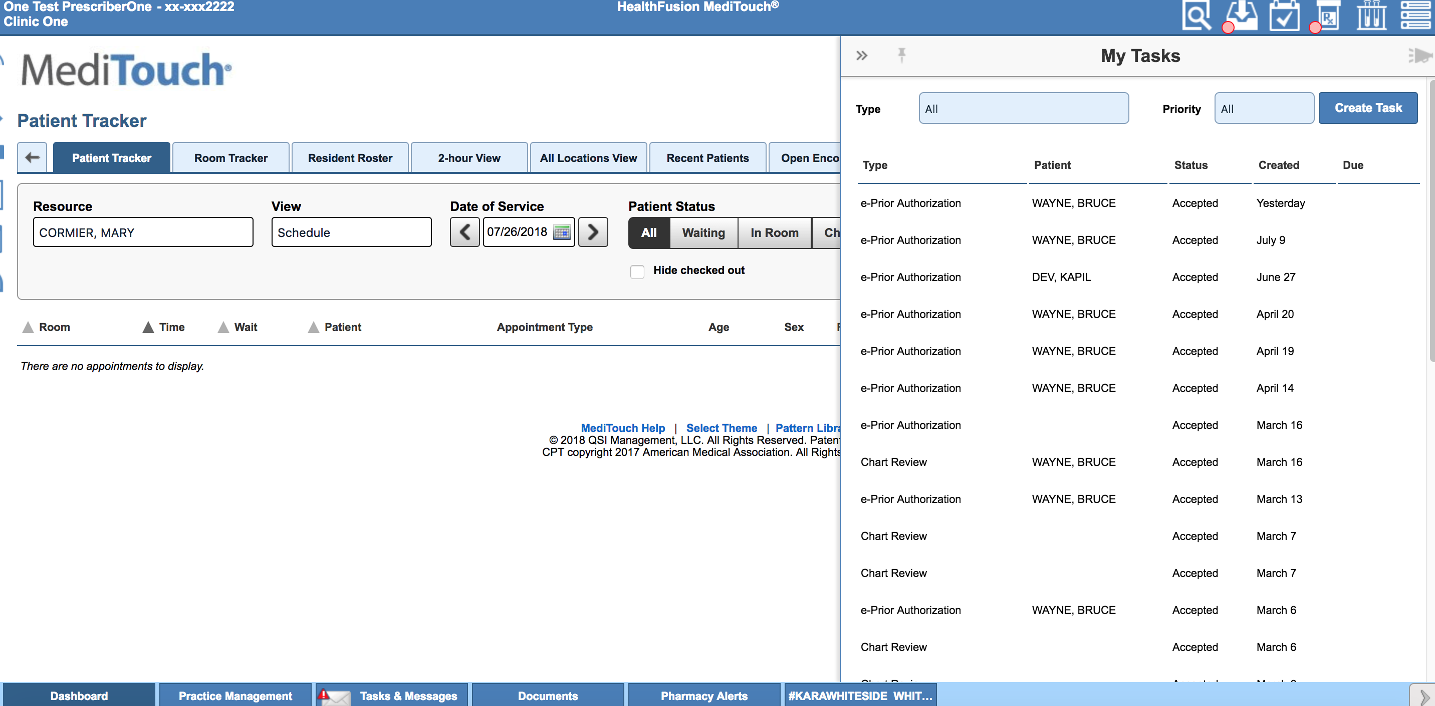
Staff- Work EPA
As a staff member, you are alerted of a new task and can open the task to address it

Slide 14
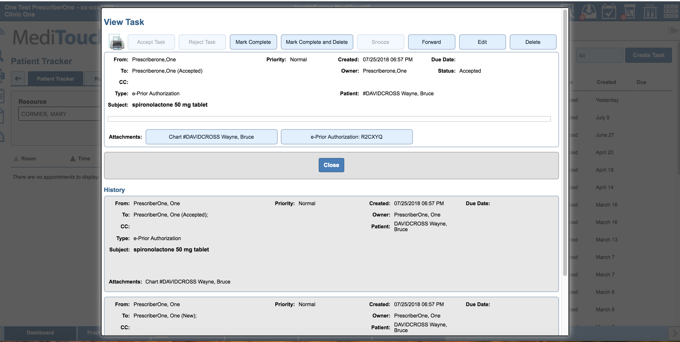
Staff- Work EPA
With in the task, the user has a link to the prior authorization

Slide 15
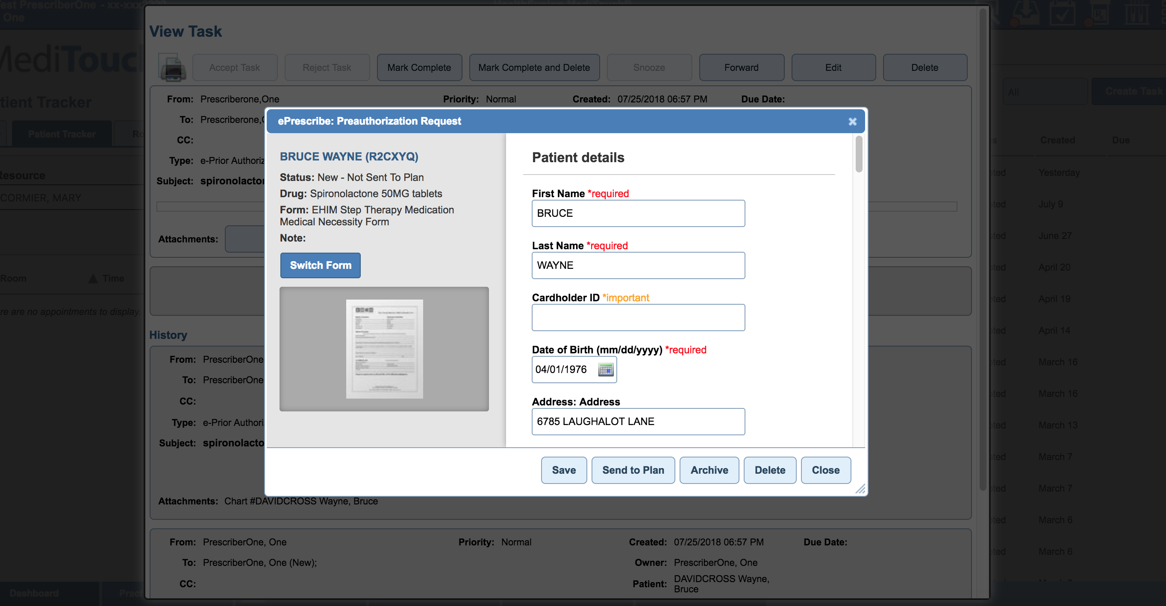
Staff- Work EPA
The staff member has the same options as the provider and can complete the ePA

Slide 16
Manage Authorizations

Slide 17
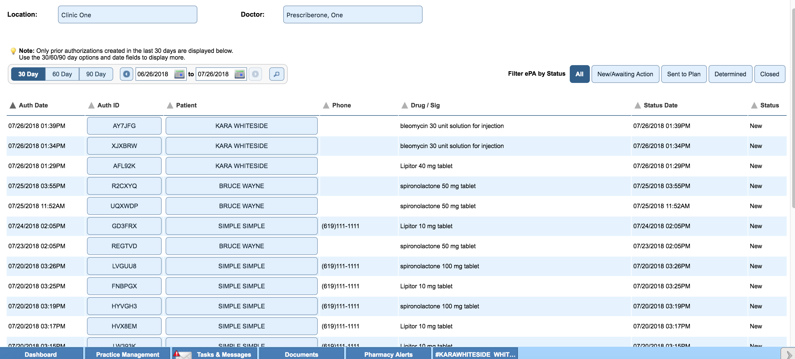
Manage EPA
To manage ePA’s we have added a Prior Authorization section in the pharmacy alert area

Slide 18
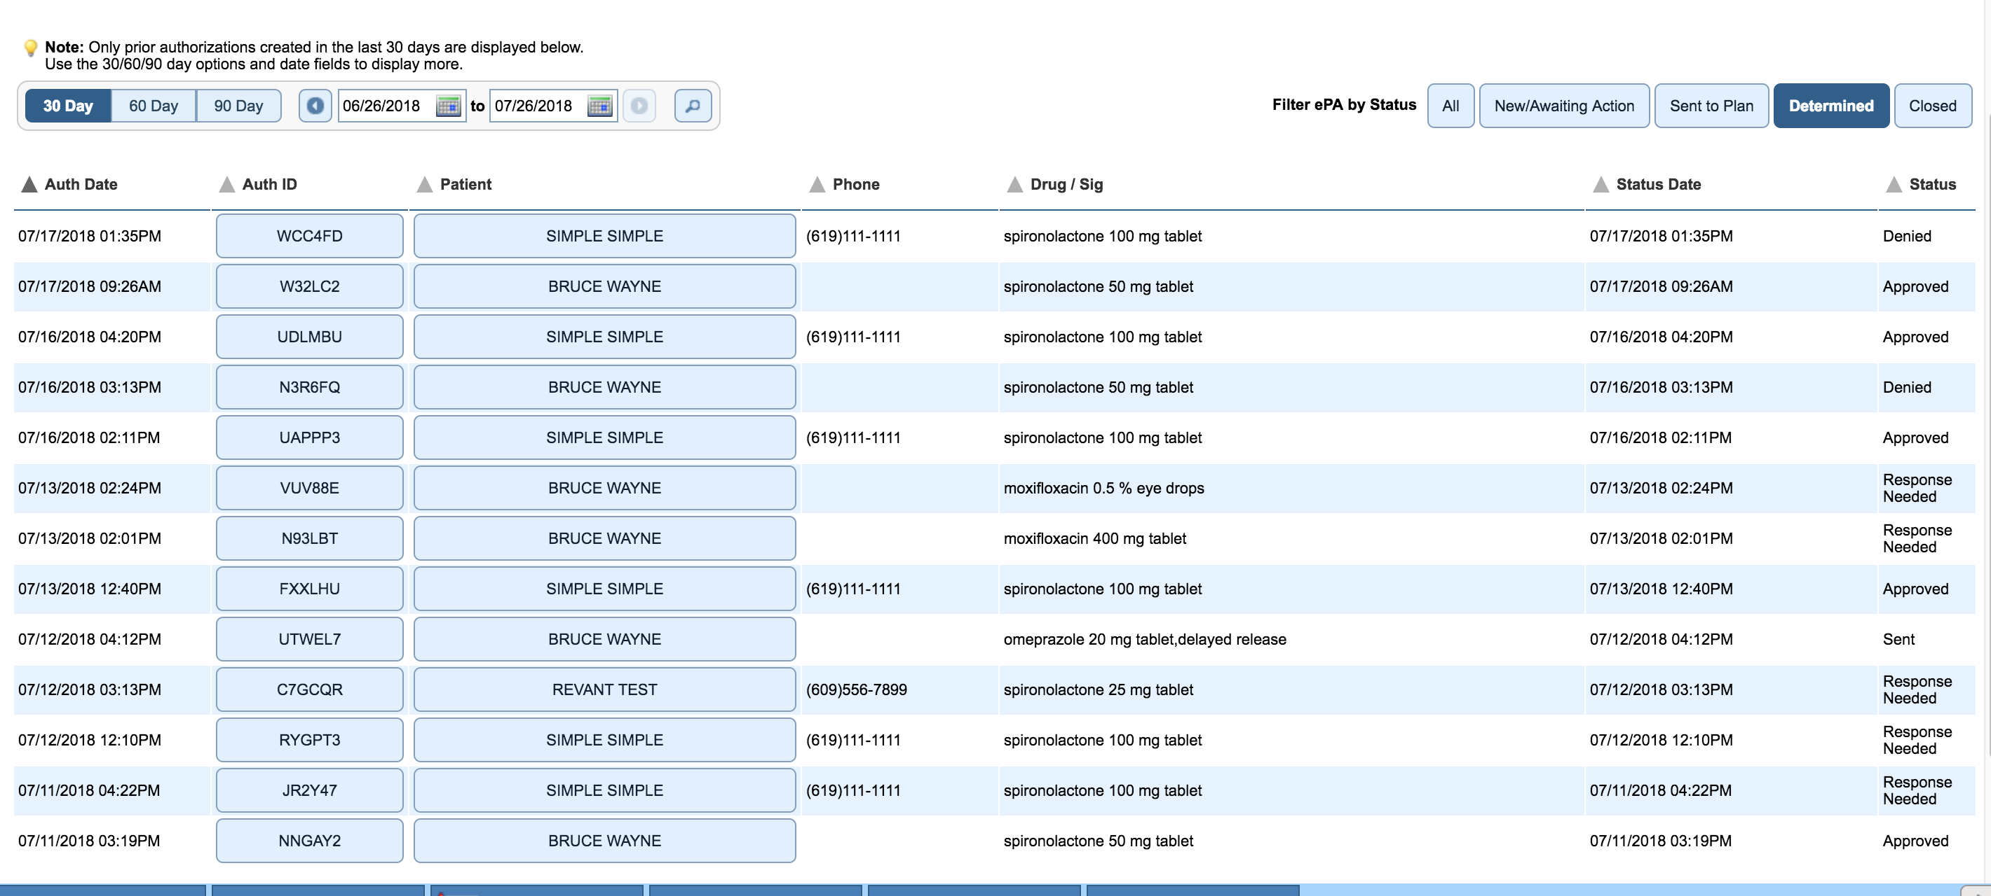
Manage EPA
A user can filter the ePAs based on status to easily review any which may need action then select an Auth ID to open a PA

Slide 19
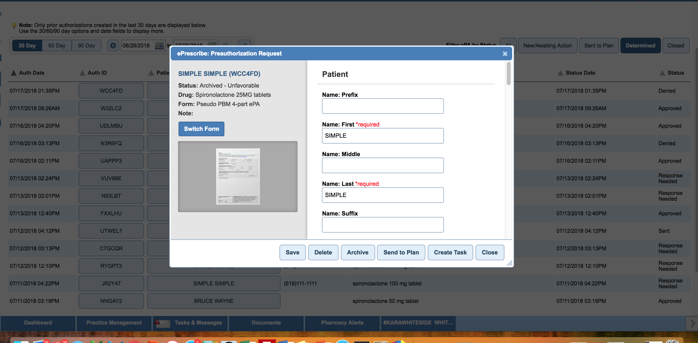
Manage EPA
Once Open, the user has all of the same abilities to work the ePA from this screen

